Slide 1
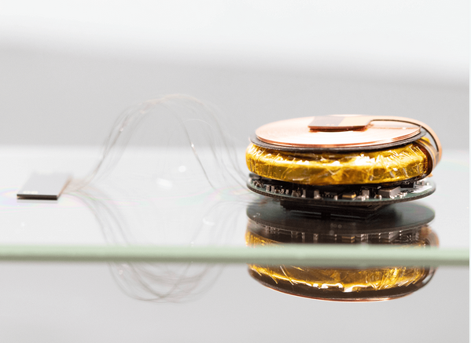
Nueralink: Uploading the Brain
Positive Impacts:
  Operate computers with the brain
  Replace the need for smartphones, tables, etc
  Cybernetic enhancements
Negative Impacts:
  Hackable
  People’s brain data sold to companies
  Cybernetic enhancements; less human more machine
What is the Nueralink?
Nueralink is a company created by our tech savior Elon Musk, aimed to create a brain-machine interface (BMI). The BMI that Nueralink is creating consists of tiny probes made of microscopic electrodes connected to various areas of the brain. These areas are the visual cortex, auditory cortex, somatosensory cortex, and motor cortex. While the BMI is connected to these parts of the brain it will be able to read the signals the brain is sending and decode these signals into a usable format for future applications.
Image Source: https://neuralink.com/approach/
Tristen Erpelding

